Slide 1
Design & Applications of Optimal Decision Making Models
最佳化決策模式設計與應用
Day 2
王 逸 琳
I-Lin Wang
ilinwang@mail.ncku.edu.tw
http://ilin.iim.ncku.edu.tw/
成功大學工業與資訊管理學系教授
2020/08/24-28 @成功校區 理學教學大樓(新大樓) 1樓36104室

Slide 2
Course Plans
Day 1: 2020/08/24 Quiz 1 [8%] (moodle or Zuvio)
  Introduction (OR, applications, model/algorithm, complexity), Project Intro.
  Software Installation & Demo (by TAs)
Day 2: 2020/08/25 Quiz 2 [8%], Project 1 due 08/29 11pm [15%]
  Basics of Linear Programming & Integer Programming; LP modeling
Day 3: 2020/08/26 Quiz 3 [8%], Project 2 due 08/30 11pm [15%]
  IP modeling techniques
Day 4: 2020/08/27 Quiz 4 [8%]
  Applications: Facility Locations, Logistics Management, Routings (TSP)
  Project Implementation help (by TAs)
Day 5: 2020/08/28 Quiz 5 [8%]
  Applications: Routings (RPP), Scheduling (RCPSP)
  Project Implementation help (by TAs)
Day 6: 2020/08/29 1-hr on-line Exam (moodle) [20%]

Slide 3
decision making
Operations Research
  examples
Mathematical Programming
  Linear Program
  Integer Program

Slide 4
An Optimization Problem
Objective function:
  Minimize cost, risk, waste,…
  Maximize profit, reliability, safety,…
Decision variables:
  # money to spend/invest, # cargo to be shipped,
  # fuel to be consumed,…
  ➔ Linear (fractional) variables
  Do it or not, which way to go, # warehouses to be built
  which train to carry which person,…
  ➔ Integral variables
Constraints:
  Resource limit (budget, capacity,…etc),
  if…then…,else then…,

Slide 5
A Linear Programming Problem
Objective Function:
  maximize the Weekly profit
Decisions variables:
  X₁ = Weekly production level of product 1
  X₂ = Weekly production level of product 2
Constraints:
  Resource capacity
  Time limit
  Order contract
  Variable Bounds

Slide 6
A Simple Linear Programming Model
Objective function:
  Max 8X₁ + 5X₂ (Weekly profit)
subject to
  2X₁ + 1X₂ ≤ 1000 (Plastic) ➔ Resource
  3X₁ + 4X₂ ≤ 2400 (Production Time) ➔ Time
  X₁ + X₂ ≤ 700 (Total production) ➔ Contract
  X₁ - X₂ ≤ 350 (Mix) ➔ Contract
  X_{j} ≥ 0, j = 1,2 ➔ Bountds
Why called LP?
  NLP, IP

Slide 7
Graphical Way to View Feasible Region
2 Degree of Freedom ➔ 2 dimensions
The non-negativity constraints
X₂
X₁

Slide 8
Linear Inequality ⬅➔ Half Space
X₂
1000
The Plastic constraint
2X₁+X₂ ≤ 1000
700
Total production constraint:
X₁+X₂ ≤ 700 (redundant)
500
Infeasible
Production
Time
3X₁+4X₂ ≤ 2400
Feasible
X₁
500
700
800

Slide 9
Intersection of Half Space
X₂
1000
The Plastic constraint
2X₁+X₂ ≤ 1000
700
Total production constraint:
X₁+X₂ ≤ 700 (redundant)
500
Infeasible
Production mix
constraint:
X₁-X2 ≤ 350
Production
Time
3X₁+4X2≤ 2400
Feasible
500
700
X₁
  Interior points.
  Boundary points.
Extreme points.
There are three types of feasible points

Slide 10
The search for an optimal solution
X₂
Start at some arbitrary profit, say profit = $2,000...
1000
Then increase the profit, if possible...
...and continue until it becomes infeasible
700
Profit =$4360
500
Learned this in high school already!!
X₁
500

Slide 11
Now What?
General Concept/Common Sense on Optimization
  E.g.: Difficulty: # of feasible solution?
Modeling Techniques
Solution Method (Algorithms)

Slide 12
LP solution methods (simplex-based)
Simplex method : primal feasible, CS condition ➔ dual feasible
  Simplex, basis, extreme point / vertex / basic feasible solution
  Optimality conditions :
    Primal / dual feasible, complementary slackness (CS) condition
Dantzig Wolfe decomposition
  Different formulation, has exponentially many variables
  In conjuction with revised simplex method & column generation
Lagrangian Relaxation
  Used when easy & hard constraints coexist
  Dual based method, Lagrangian multiplier (dual variable, penalty)
  Seek opt LM: subgradient method, bundle method,…, etc.

Slide 13
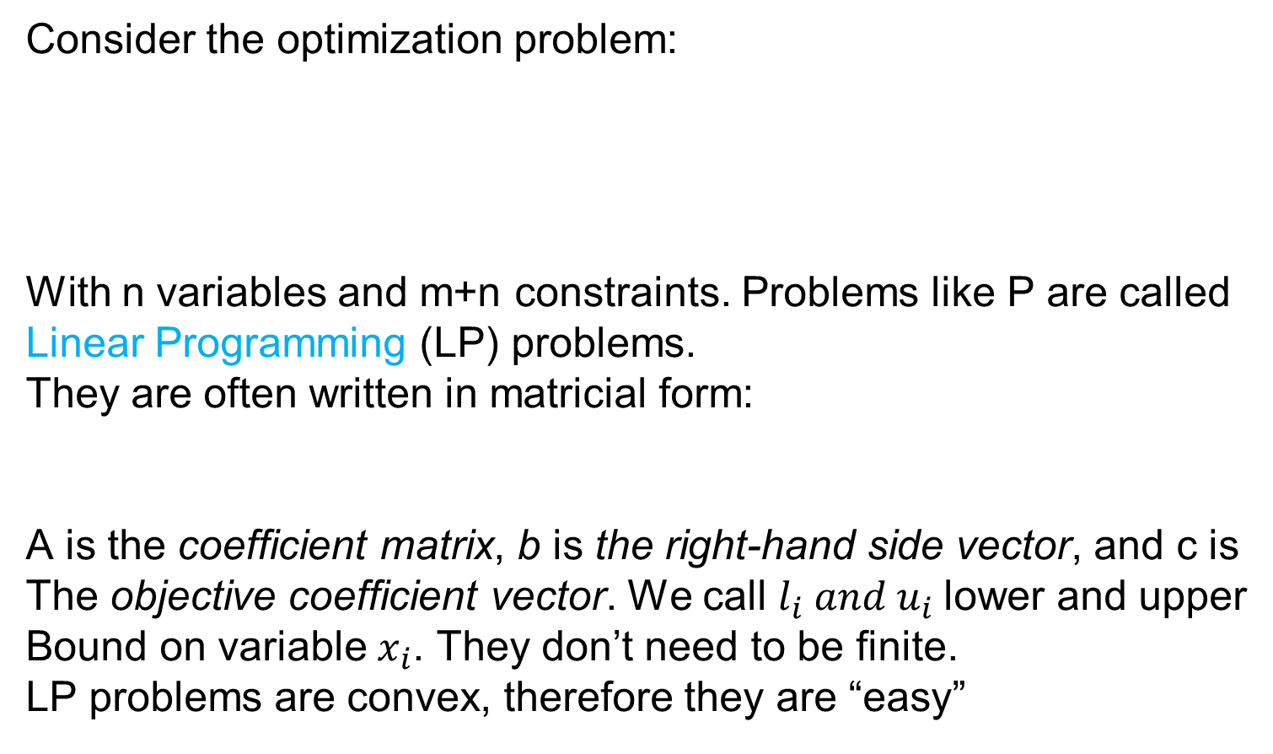
Linear programming

Slide 14
Example1
You are cast on an island in the middle of the pacific, and the only source of food is a well-known restaurant, here’s the menu:
Each food has a different combination of nutrient (proteins, Vitamin A, Iron, etc.) and a cost. You want to
► get the necessary nutrients every day (constraint!)
► minimize the total cost of the foods (objective function)
► what are the variables?
QP: Quarter pounder |  | FR: Fries(small)
MD: Mclean Deluxe |  | SM: Sausage McMuffin
BM: Big Mac |  | 1M: 1% Lowfat Milk
FF: Filet-O-fish |  | OJ: Orange Juice
MC: McGrilled Chicken

Slide 15
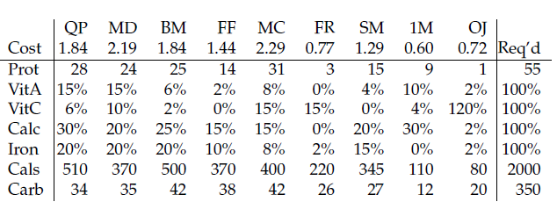
Nutrients

Slide 16
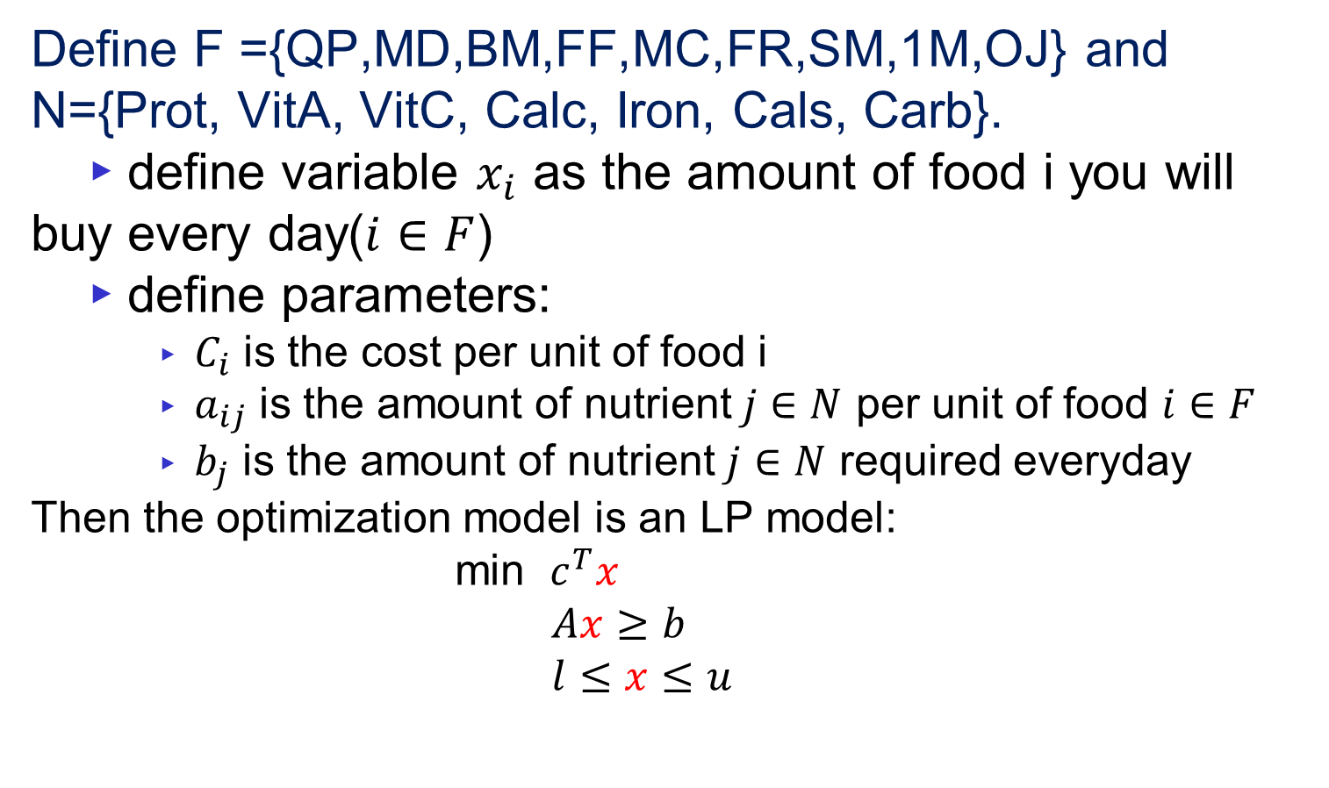
Model

Slide 17
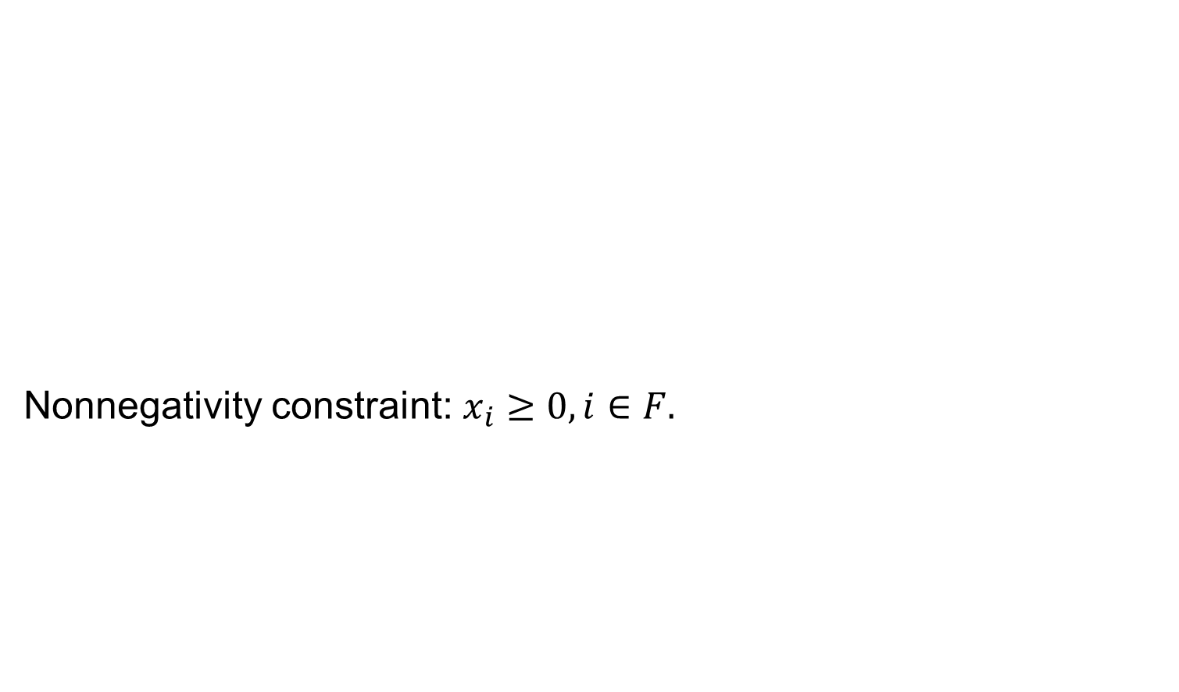
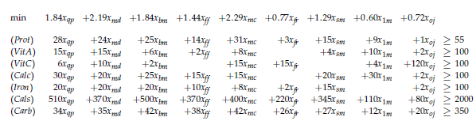
Overall model

Slide 18

Another example2
The manager of a post office is hiring new employees
They can be full or part time. The part time can be 1% to 99%, this is only to simplify the problem. Rules:
► at least these many employees each day of the week
► (state regulations impose)that an employee works five days in a row and then receives two days off
► that the number of employees is minimum
What are the variable of the problem?
► the number of employees working each day?
► the total number of employees to hire?
What do I (as a boss) want to know at the end
see Winstion&Venkataramanan, page 72, example 7. there is a slight difference: where?

Slide 19
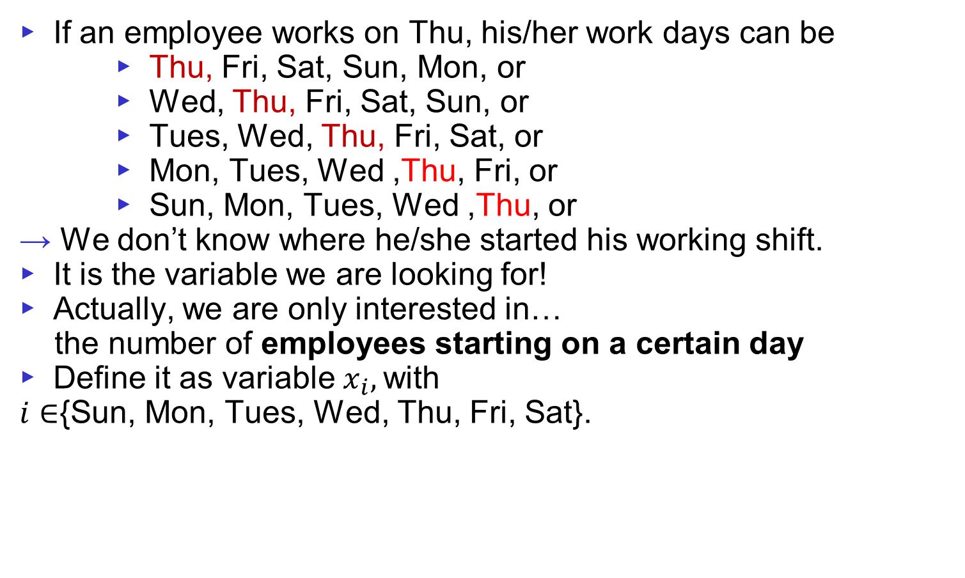
What do we want to know

Slide 20
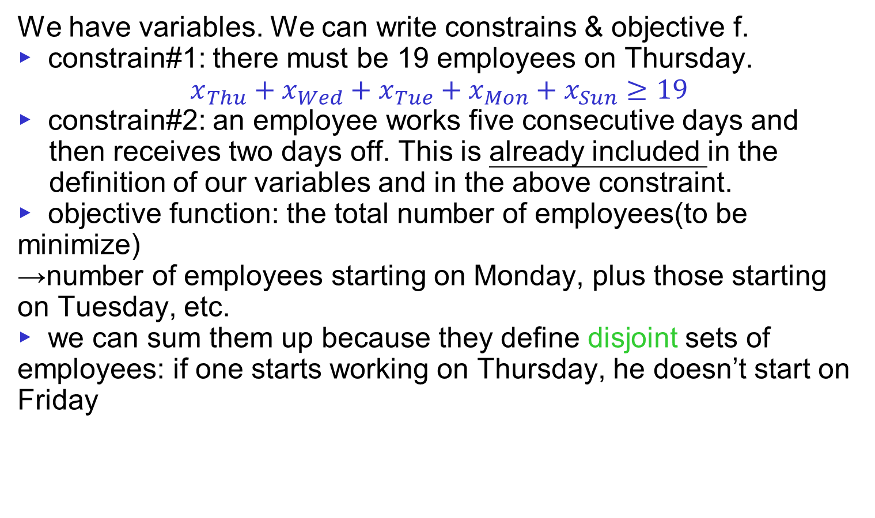
Now that we know what we are looking for

Slide 21
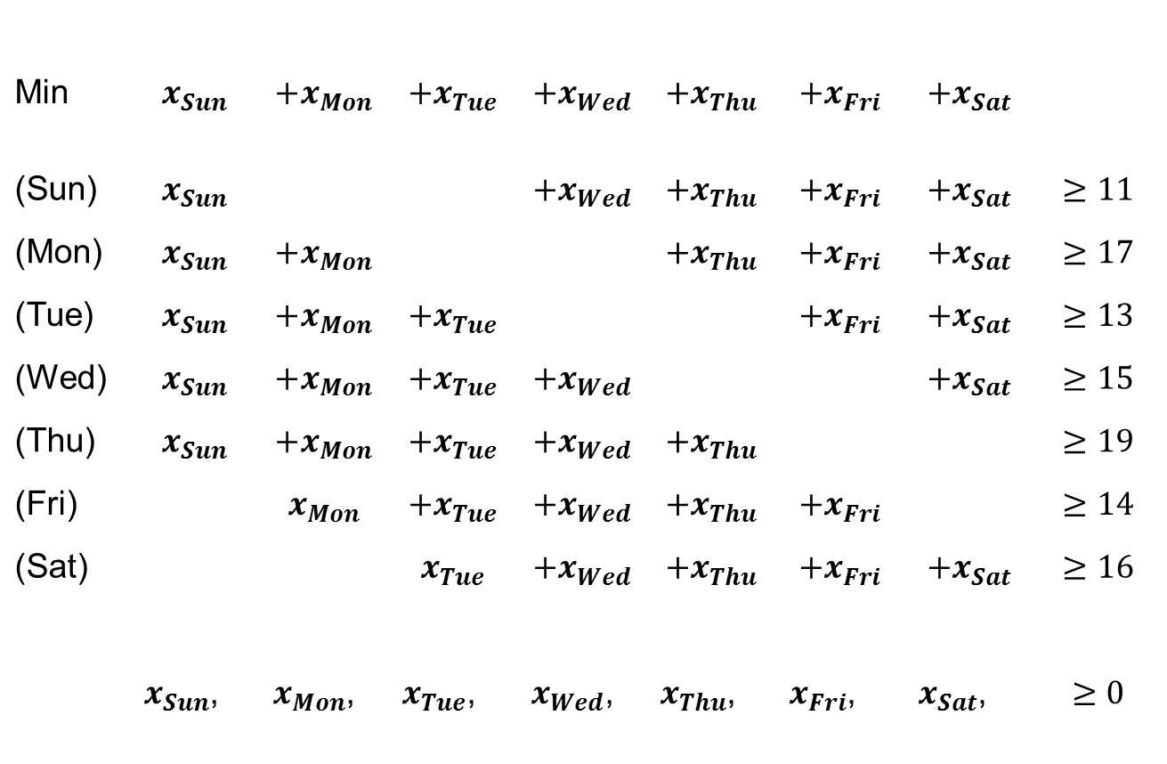
The model
Min
(Sun)
(Mon)
(Tue)
(Wed)
(Thu)
(Fri)
(Sat)
►

Slide 22
The solution
LP: with part-time contracts(here 1/3 – time contract used).
IP: solution with only full-time contracts.
 | Sun | Mon | Tue | Wed | Thu | Fri | Sat | Total
LP | 5 | 4/3 | 16/3 | 0 | 22/3 | 0 | 10/3 | 67/3
IP | 4 | 1 | 6 | 0 | 8 | 0 | 4 | 23 ≥ 67/3
►

Slide 23
LP example: short term financial planning
► Your company makes tape recorders(TR) and radios(RD)
► Returns are:
TR:100$(price) – 50$(labor) – 30$ (raw m.) = 20$
RD:90$(price) – 35$(labor) – 40$ *(raw m.) = 15$
► Raw material is sufficient to produce 100TRs and100RDs
See winstion&venkataramanan, p.82

Slide 24
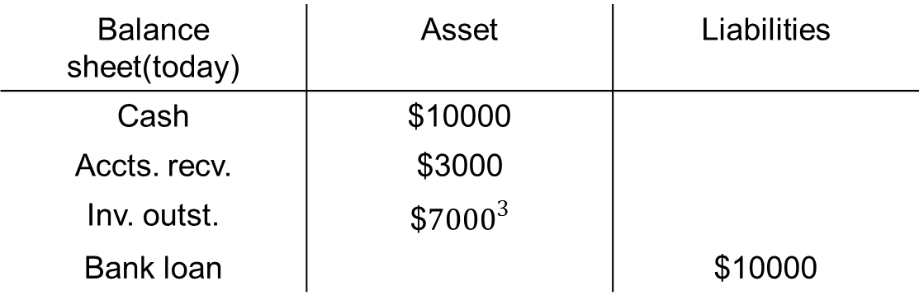
LP example: short term financial planning
Balance sheet(today) | Asset | Liabilities
Cash | $10000
Accts. recv. | $3000
Inv. outst. | $${7000}^{3}$
Bank loan |  | $10000
Before the end of the mouth,
► We will collect soon $2000 of accts.
► We will receive new inventory worth $2000
► We must pay $1000 of loan and another $1000 for rental
► Management: “on 09/30 cash has to be at least $4000”
► Bank requires that assets / liability ratio be at least 2

Slide 25
LP example: short term financial planning
How many TRs and RDs do we produce this mouth to maximize return?
$7000=$3000*100+$40*100.

Slide 26
LP example: short term financial planning
► return on each TR is $20,RD is $15
► suppose t is #TR and r is #RD
► balance sheet in a mouth:
BS(09/30) | Assets | Liabilities
Cash | $10,000 +$2,000-$1,000-$1,000 -$50t-$35r
Accts. recv. | $3,000 -$2,000+$100t+$90r
Inv. outst. | $7,000 +$2,000-$30t-$40r
Bank loan |  | $10,000 +$2,000-$1,000

Slide 27
LP example: short term financial planning
► return on each TR is $20,RD is $15
► suppose t is #TR andr is #RD
► balance sheet in a mouth:
► Cash ≧$4,000 means $10,000-$50t-$35r ≧$4,000
→ $50t+$35r≦$6,000
BS(09/30) | Assets | Liabilities
Cash | $10,000-$50t-$35r
Accts. recv. | $1,000+$100t+$90r
Inv. outst. | $9,000-$30t-$40r
Bank loan |  | $11,000

Slide 28
LP example: short term financial planning
Max | $20t+15r
 | $50t+35r | ≦$6,000
 | $20t+$15r | ≧$2,000
 | T | ≦100
 | r | ≦100
 | t , r | ≧0
Notes:
Proof of Thm 4.4: if U=V, just select that vertex; if all vertices are different, done; o.w. at least 2 vertices on the path are the same, deleting those edges in between will still keep a path connecting U,V. keep doing these deletion until there is no repeated vertices; since the # of vertices are finite, this process will give a simple U-V path
Chinese postman problem:
Find a minimum length closed walk that traverses each edge AT LEAST ONCE
Fining an optimal solution is NP-complete

Slide 29
LP example: Project selection⁵
We have 5 investment opportunities over a 2-year term.
► i.e. we’ll invest in the same funds this and next year
► each has two cash outflows, for 2009 and for 2010, and
► a Net Present Value (NPV)⁴
► available cash: 40M$ this year, estimate 20M $ next year
What investment(s) get the maximum total NPV?
What percentage of each?
⁴The amount by which the investment will increase the company’s value.
⁵Winston&Venkataramanan, example 10,page 80.
investment | 1 | 2 | 3 | 4 | 5
(a_{i})Cash outflow, 2009 | 11 | 53 | 5 | 5 | 29
(b_{i}) , 2010 | 3 | 6 | 5 | 1 | 34
(v_{i}) | 13 | 16 | 16 | 14 | 39
Notes:
Pf:
(a)<= : when the circuit passes a vertex, there is an entering edge, and a leaving edge (different from the entering edge), since each edge is passed exactly once, thus there are 2|V| edges which is an even #
=> choose a starting vertex u, if there is a loop on u, pass it, then leave u along an edge (u,u1) (it must exist since there are more than 2 vertices and the graph is connected), in u1, if there is a loop on u1, pass it, then leave u1 along an edge other than any edge that has been passed like (u1,u) (it must exist since each vertex has even degree) to vertex u2. Repeat these steps until finally we return u. (this has to happen since # edge is finite and the graph is connected) Then we get a circuit C1 from u to u.
If C1 covers all the edge, then we get an Euler circuit, done.
Otherwise, we delete all the edges on C1 from G, then delete all the isolated vertices from G, and obtain the remaining subgraph G1.
On G1, we choose a vertex v (it exists due to connected graph), and do the same steps as above to form a circuit C2 back to v.
Now, combine C1 & C2, we get a larger circuit C’ starts from u along C1 to v, then along C2 back to v, and along C1 back to u. if C’ covers all the edges, we are done. Otherwise, we repeat the same procedures until finally all the edges are covered. The algorithm will stop since the graph is finite, at which time, we obtain an Euler circuit by combining all the smaller circuits.
(b,c)<= trivial
=> Add an artificial edge between the 2 vertices with odd degrees, we can form an Euler circuit, then we remove the artificial edge and obtain the Euler path

Slide 30
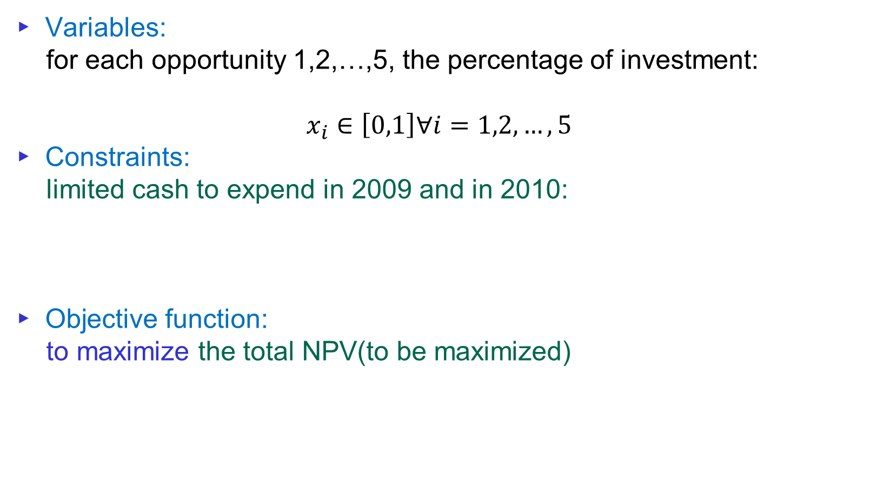
LP example: Project selection
► Variables:
for each opportunity 1,2,…,5, the percentage of investment:
$$x_{i}∈\left[0,1\right]∀i=1,2,…,5$$
► Constraints:
limited cash to expend in 2009 and in 2010:
► Objective function:
to maximize the total NPV(to be maximized)

Slide 31
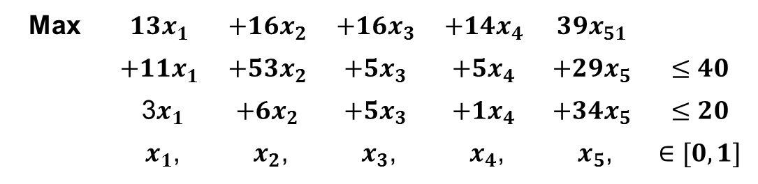
LP example: Project selection
Max | $$13x_{1}$$ | $$+16x_{2}$$ | $$+16x_{3}$$ | $$+14x_{4}$$ | $$39x_{51}$$
 | $$+11x_{1}$$ | $$+53x_{2}$$ | $$+5x_{3}$$ | $$+5x_{4}$$ | $$+{29x}_{5}$$ | $$≤40$$
 | 3$x_{1}$ | $$+6x_{2}$$ | $$+5x_{3}$$ | $$+1x_{4}$$ | $$+34x_{5}$$ | $$≤20$$
 | $x_{1}$, | $x_{2}$, | $x_{3}$, | $x_{4}$, | $x_{5}$, | $$∈[0,1]$$

Slide 32
Integer Programming
Modeling:
  Facility Location as an Example
Solution Method:
  Branch & Bound
  LP Relaxation
  Lagrangean Relaxation

Slide 33
Integer Programming Modeling
Programming = Planning in this context
Origins go back to military logistics in WWII (1940s).
In a survey of Fortune 500 firms, 85% of those responding said that they had used linear or integer programming.
Why is it so popular?
  Many different real-life situations can be modeled as integer programs (IPs).
  There are efficient algorithms to solve IPs.

Slide 34
Standard form of integer program (IP)
maximize c₁x₁+c₂x₂+…+c_{n}x_{n} (objective function)
subject to
a₁₁x₁+a₁₂x₂+…+a_{1n}x_{n} ≤ b₁ (functional constraints)
a₂₁x₁+a₂₂x₂+…+a_{2n}x_{n} ≤ b₂
….
a_{m1}x₁+a_{m2}x₂+…+a_{mn}x_{n} ≤ b_{m}
x₁, x₂ , …, x_{n} ∈ Z₊ (set constraints)
Note: Can also have equality or ≥ constraint
in non-standard form.

Slide 35
Standard form of integer program (IP)
In vector form:
maximize cx (objective function)
subject to Ax ≤ b (functional constraints)
x ∈ (set constraints)
Input for IP: 1×n vector c, m×n matrice A, m×1 vector b.
Output of IP: n×1 integer vector x .
Note: More often, we will consider
mixed integer programs (MIP),
that is, some variables are integer,
the others are fractional (e.g. real number).

Slide 36
Example of Integer Program
(Production Planning-Furniture Manufacturer)
Technological data:
Production of 1 table requires 5 ft pine, 2 ft oak, 3 hrs labor
1 chair requires 1 ft pine, 3 ft oak, 2 hrs labor
1 desk requires 9 ft pine, 4 ft oak, 5 hrs labor
Capacities for 1 week: 1500 ft pine, 1000 ft oak,
20 employees (each works 40 hrs).
Market data:
Goal: Find a production schedule for 1 week
that will maximize the profit.
 | profit | demand
table | $12/unit | 40
chair | $5/unit | 130
desk | $15/unit | 30

Slide 37
Production Planning-Furniture Manufacturer: modeling the problem as integer program
The goal can be achieved
by making appropriate decisions.
First define decision variables:
Let x_{t} be the number of tables to be produced;
x_{c} be the number of chairs to be produced;
x_{d} be the number of desks to be produced.
(Always define decision variables properly!)

Slide 38
Production Planning-Furniture Manufacturer: modeling the problem as integer program
Objective is to maximize profit:
max 12x_{t} + 5x_{c} + 15x_{d}
Functional Constraints
capacity constraints:
pine: 5x_{t} + 1x_{c} + 9x_{d} ≤ 1500
oak: 2x_{t} + 3x_{c} + 4x_{d} ≤ 1000
labor: 3x_{t} + 2x_{c} + 5x_{d} ≤ 800
market demand constraints:
tables: x_{t} ≥ 40
chairs: x_{c} ≥ 130
desks: x_{d} ≥ 30
Set Constraints
x_{t} , x_{c} , x_{d} ∈ Z₊

Slide 39
Network Notation
2
4
2
4
1
5
7
1
5
7
3
6
3
6
An Undirected Graph or
Undirected Network
A Directed Graph or
Directed Network
Network (or graph) G = (N, A)
N : Node Set = {1, 2, 3, 4, 5, 6, 7}
A : Arc Set = {(1, 2), (1, 3), (2, 3), (2, 4), (3, 6), (4, 5), (4, 7), (5, 2), (5, 3), (5, 7), (6, 7)}

Slide 40
Tails and Head Nodes
2
4
1
5
7
3
6
Tail Node : Node i is the tail node of arc (i, j)
Head Node : Node j is the head node of arc (i, j)
Endpoints : Nodes i and j are endpoints of arc (i, j)
(outgoing) Arc Adjacency List A(i) = {(i, j) : (i, j) ∈ A}
Observe that

Slide 41
Walks
2
4
1
5
7
3
6
Subgraph: G' = (N', A') is a subgraph of G = (N, A)
if N' ⊆ N and A' ⊆ A.
Spanning Subgraph: G' = (N', A') is a spanning subgraph of G = (N, A) if N' = N and A' ⊆ A.
Walk: A walk in a directed graph G is a subgraph of G consisting of a sequence of nodes and arcs.
Directed Walk: A directed walk in which all arcs have the same orientation.

Slide 42
Paths and Cycles
2
4
2
4
1
5
7
1
5
7
3
6
3
6
(simple) Path : A walk without any repetition of nodes.
Directed Path: A directed walk without any repetition of nodes. (thus, same orientation)
(simple) Cycle: A walk without any repetition of nodes except the same starting and ending nodes.
Directed Cycle: A directed version of a cycle.
Acyclic Network: A network that has no directed cycle.

Slide 43
Network Connectivity
2
4
2
4
1
5
7
1
5
7
3
6
3
6
Connected Graph
  every two nodes are connected by a path.
Disconnected Graph
  some nodes are not mutually connected
Components
  maximally connected subgraphs of a disconnected graph.
Notes:
Strongly connected: every node to every other node!! Check definitions in the book.

Slide 44
Trees
Tree: A tree is a connected graph that contains no cycle.
2
4
2
4
1
7
1
3
6
3
6
Properties:
A tree on n nodes contains exactly n-1 arcs.
A tree has at least two leaf nodes.
Every two nodes of a tree are connected by a unique path.

Slide 45
Spanning Trees
Spanning Tree: A subgraph of a graph which is a tree and contains every node of the graph.
2
4
2
4
1
5
7
1
5
7
3
6
3
6
Forest: A graph that contains no cycle is a forest.
thus a forest may contains several components (trees)
A forest on n nodes and k components has n-k arcs.

Slide 46
Where Network Flows Arise
Transportation
  Transportation of goods over transportation networks
  Scheduling of fleets of airplanes: time/space networks
Manufacturing
  Scheduling of goods for manufacturing
  Flow of manufactured items within inventory systems
Communications
  Design and expansion of communication systems
  Flow of information across networks
Personnel Assignment
  Assignment of crews to airline schedules
  Assignment of drivers to vehicles
Notes:
See if I can tie this back to the student’s comments about thesis work.

Slide 47
The Shortest Path Problem
Consider a network G = (N, A) in which there is an origin node s and a destination node t.
standard notation: n = |N|, m = |A|
Determine a shortest path :
from s to t (1-ALL)
from each node to each other node (ALL-ALL)
from some nodes to some other nodes (SOME-SOME)
2
4
4
Applications:
Finding a path
of minimum length
taking minimum time
of maximum reliability
2
2
1
1
2
3
1
6
s
4
2
t
3
3
5
A Network with Arc Lengths

Slide 48
1-1 Shortest Path LP Formulation
2
4
4
1-1 SP: s→t
Decision Variables
+1
2
2
-1
1
1
2
3
1
6
s
4
2
t
3
3
5
Objective function:
Flow Balance Constraints:
Bounds:

Slide 49
1-ALL Shortest Path LP Formulation
-1
4
-1
2
4
1-ALL SP: s→all nodes
Decision Variables
+5
2
2
-1
1
1
2
3
1
6
s
4
2
t
3
3
5
-1
-1
Objective function:
Flow Balance Constraints:
Bounds:

Slide 50
General Form of SP LP formulation
50
1-ALL SP
1-1 SP
Special Math Properties:
  One redundant constraint
  Total unimodularity (TUM)➔ LP solution = IP solution
  by simplex method

Slide 51
A Framework for Global Site Location
Competitive STRATEGY
GLOBAL COMPETITION
PHASE I
Supply Chain
Strategy
INTERNAL CONSTRAINTS
Capital, growth strategy,
existing network
TARIFFS AND TAX
INCENTIVES
PRODUCTION TECHNOLOGIES
Cost, Scale/Scope impact, support
required, flexibility
REGIONAL DEMAND
Size, growth, homogeneity,
local specifications
PHASE II
Regional Facility
Configuration
COMPETITIVE
ENVIRONMENT
POLITICAL, EXCHANGE
RATE AND DEMAND RISK
PHASE III
Desirable Sites
AVAILABLE
INFRASTRUCTURE
PRODUCTION METHODS
Skill needs, response time
FACTOR COSTS
Labor, materials, site specific
PHASE IV
Location Choices
LOGISTICS COSTS
Transport, inventory, coordination
5.3: A Framework for Network Design Decisions
Notes:
Notes:

Slide 52
Models for Facility Location & Capacity Allocation
Maximize overall profitability of SC, while provide appropriate responsiveness
Network optimization models:
  Decide facility location, capacity for each facility (location/capacity unchanged in yrs)
  Assign current demand to the available facilities, identify transportation lanes
  Annual basis as demand, prices, tariffs change
Required info:
  Location of supply sources & markets, potential facility sites
  Demand forecast by market
  Facility, labor, material costs by site
  Transportation cost between each pair of sites
  Inventory costs by site
  Sale price of product in different regions
  Taxes, tariffs as product is moved between locations
  Desired response time, other service factors
5.4: Models for Facility Location & Capacity Allocation

Slide 53
Phase II: Plant Location with Multiple Sourcing
n: # potential plant location/capacity (supply)
m: # markets (demand)
D_{j}: annual demand from market j
K_{i}: potential capacity of plant I
F_{i}: annual fixed cost to open factory I
C_{ij}: cost of producing/shipping 1 unit from factory i to market j (including production, inventory, transportation, duties)
y_{i} = 1 if plant is located at site i, 0 otherwise
x_{ij} = Quantity shipped from plant site i to customer j
Mixed Integer Linear Programming (MILP)
5.4: Models for Facility Location & Capacity Allocation
Notes:
Notes:

Slide 54
Phase III: Gravity Methods for Location
Identify potential locations in each region
Locating a single facility receiving raw material from supply sources, shipping finished product to markets
Ton Mile-Center Solution
  x,y: Warehouse Coordinates
  x_{i}, y_{i} : Coordinates of delivery location i
  d_{i} : Distance to delivery location i
  F_{i} : Cost of shipping one unit per mile between facility and supply/demand site
  D_{i} : Quantity to be shipped between facility and supply/demand
  FD_{i} : Annual cost per mile of shipping Di between facility and supply/demand
5.4: Models for Facility Location & Capacity Allocation

Slide 55
Phase IV: Network Optimization Models
Allocating demand to production facilities
Locating facilities and allocating capacity
Key Costs:
Fixed facility cost
Transportation cost
Production cost
Inventory cost
Coordination cost
Which plants to establish? How to configure the network?
5.4: Models for Facility Location & Capacity Allocation
Notes:
Notes:

Slide 56
Demand Allocation Model
Which market is served by which plant?
Which supply sources are used by a plant?
x_{ij} = Quantity shipped from plant site i to customer j
Linear Programming
5.4: Models for Facility Location & Capacity Allocation

Slide 57
Capacitated Plant Location Model with Single Sourcing
Single sourcing: Each market is supplied from only one factory
x_{ij} =1: market j is supplied by factory i
=0: o.w.
y_{i} =1: factory is located at site i
=0: o.w.
0,1-Integer Programming
5.4: Models for Facility Location & Capacity Allocation

Slide 58
Locating Plants & Warehouses Simultaneously
c_{hi}
c_{ie}
c_{ej}
Suppliers
index: h
# suppliers: l
S_{h}: supply capacity
Plants
index: i
# plants: n
K_{i}: potential capacity
F_{i}: fixed cost
Warehouses
index: e
# warehouses: t
W_{e}: potential capacity
f_{e}: fixed cost
Markets
index: j
# markets: m
D_{j}: annual demand
y_{i}={0,1} to build plant (factory) or not
y_{e}={0,1} to build warehouse or not
x_{ej}: amount shipped from warehouse e to market j
x_{ie}: amount shipped from plant I to warehouse e
x_{hi}: amount shipped from supplier h to factory i
MIP
5.4: Models for Facility Location & Capacity Allocation

Slide 59
Locating Plants & Warehouses Simultaneously
c_{hi}
c_{ie}
c_{ej}
Suppliers
S_{h}: supply capacity
Plants
K_{i}: potential capacity
F_{i}: fixed cost
Warehouses
W_{e}: potential capacity
f_{e}: fixed cost
Markets
D_{j}: annual demand
MIP
5.4: Models for Facility Location & Capacity Allocation

Slide 60
Accounting for Taxes, Tariffs, Customer Requirements
Minimize cost → maximize revenue
Relax demand satisfied constraint (= → <=)
To satisfy customer requirements, may provide more transportation modes ➔
5.4: Models for Facility Location & Capacity Allocation

Slide 61
Role of Aggregate Planning in a Supply Chain
Main objective: to specify operational parameters over the time horizon:
  Production rate: units per unit time
  Workforce: workers/capacity needed
  Overtime: overtime production planned
  Machine capacity level: machine capacity needed
  Subcontracting: subcontracted capacity required
  Backlog: demand unsatisfied
  Inventory on hand: inventory planned
Allows the SC to alter capacity allocation and change supply contracts
All supply chain stages should work together on an aggregate plan that will optimize supply chain performance

Slide 62
The Aggregate Planning Problem
Given the demand forecast for each period in the planning horizon, determine the production level, inventory level, and the capacity level for each period that maximizes the firm’s (supply chain’s) profit over the planning horizon
Specify the planning horizon (typically 3-18 months)
Specify the duration of each period
Specify key information required to develop an aggregate plan

Slide 63
Key Information Needed for an Aggregate Plan
Demand forecast in each period
Production costs
  labor costs, regular time ($/hr) and overtime ($/hr)
  subcontracting costs ($/hr or $/unit)
  cost of changing capacity: hiring or layoff ($/worker) and cost of adding or reducing machine capacity ($/machine)
Labor/machine hours required per unit
Inventory holding cost ($/unit/period)
Stockout or backlog cost ($/unit/period)
Constraints: limits on overtime, layoffs, capital available, stockouts and backlogs

Slide 64
Outputs of Aggregate Plan
Production quantity from regular time, overtime, and subcontracted time: to determine number of workers and supplier purchase levels
Inventory held: to determine warehouse space and working capital
Backlog/stockout quantity: to determine customer service levels
Workforce hired/laid off: to determine any labor issues that will be encountered
Machine capacity increase/decrease: to determine if new production equipment needs to be purchased
A poor aggregate plan can result in lost sales, lost profits, excess inventory, or excess capacity

Slide 65
Aggregate Planning
Starting inventory: 1000 units; ending inventory at least 500 units
There is no initial backlog; overtime hr can’t exceed 10hr/person/month
Notes:
Notes:

Slide 66
Aggregate Planning (Define Decision Variables)
W_{t} = Workforce size for month t, t = 1, ..., 6
H_{t} = Number of employees hired at the beginning of month t,
t = 1, ..., 6
L_{t} = Number of employees laid off at the beginning of month t,
t = 1, ..., 6
P_{t} = Production in month t, t = 1, ..., 6
I_{t} = Inventory at the end of month t, t = 1, ..., 6
S_{t} = Number of units stocked out at the end of month t,
t = 1, ..., 6
C_{t} = Number of units subcontracted for month t, t = 1, ..., 6
O_{t} = Number of overtime hours worked in month t, t = 1, ..., 6
Notes:
Notes:

Slide 67
Aggregate Planning (Define Objective Function)
4*8*20
Regular time labor cost
($4/hr*8hr/day*20day/month)
Overtime labor cost
Hiring/layoff cost
Holding inventory/stocking out cost
Production/subcontracting cost
Notes:
Notes:

Slide 68
Aggregate Planning (Define Constraints Linking Variables)
Workforce size for each month is based on hiring and layoffs
Notes:
Notes:

Slide 69
Aggregate Planning (Constraints)
Production for each month cannot exceed capacity
8*20/4
Notes:
Notes:

Slide 70
Aggregate Planning (Constraints)
Inventory balance for each month
Notes:
Notes:

Slide 71
Aggregate Planning (Constraints)
Over time for each month
Notes:
Notes:

Slide 72
Some Parameters
Average seasonal inventory
Average flow time = average inventory / throughput

Slide 73
Q & A
Thanks!
I-Lin Wang (王逸琳)
Professor
Dept of Industrial & Information Management
National Cheng Kung University
http://ilin.iim.ncku.edu.tw/

